Slide 1
Introduction to Java
String
In java strings are object which represent consequence of characters.
String class is used to create string object.
Example,
char[] ch={'j','a','v','a',‘w',‘o',‘r',‘l',‘d'};
String s=new String(ch);
(Or)
String s="javaworld";
There are two ways to create String object:
By string literal
By new keyword

Slide 2
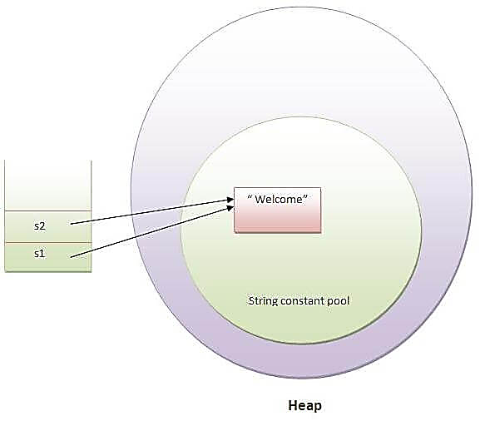
Introduction to Java
By using String literal
Java String literal is created by using double quotes.
Example: String s="welcome";
Each time you create a string literal, the JVM checks the string constant pool first.
Example :
String s1="Welcome";
String s2="Welcome"; //will not create new instance

Slide 3
Introduction to Java
By new keyword
We can create an object to String class by allocating memory dynamically using new operator. This is just like creating an object to any class.
Example: String s=new String("Welcome");//creates two objects and one reference variable
In such case, JVM will create a new string object in normal (non pool) heap memory and the literal "Welcome" will be placed in the string constant pool. The variable s will refer to the object in heap (non pool).

Slide 4
Introduction to Java
String Example:
public class StringExample{
public static void main(String args[]){
String s1="java";//creating string by java string literal
char ch[]={'s','t','r','i','n','g','s'};
String s2=new String(ch);//converting char array to string
String s3=new String("example");//creating java string by new keyword
System.out.println(s1);
System.out.println(s2);
System.out.println(s3);
}
}

Slide 5
Introduction to Java
Immutable
In java, String objects are immutable, immutable means unmodified or unchanged.
Once string object is created its data or state it can’t be changed but new string object can be created.
For mutable string, you can use StringBuffer and StringBuilder classes.
Advantage : Less memory
Disadvantage: Less efficient

Slide 6
java provides + operator to concatenate strings with each other, actually JVM uses StringBuffer concept behind it
String s = "";
s = s + "a" + "b";
How can this be possible if Strings are constant? The answer lies in the fact that the Java compiler uses StringBuffer objects to accomplish the string manipulations. This code would be rendered as something similar to the following by the Java compiler:
String s = "";
s = new StringBuffer("").append("a").append("b").toString();

Slide 7
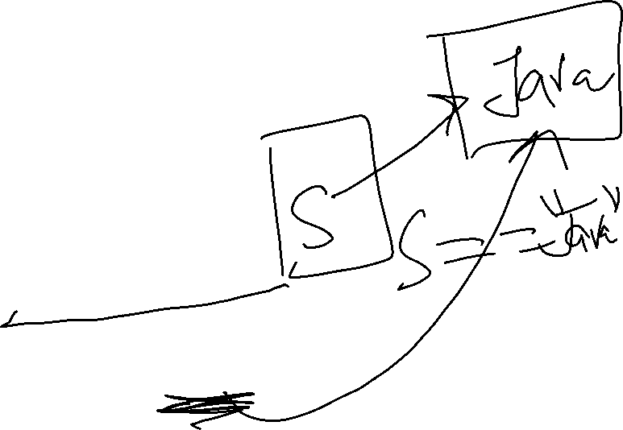
Introduction to Java
Java String Class Methods
substring(int begin):
Returns substring from begin index to end of the string.
Example: String s=“Welcome”;
System.out.pintln(s.substring(2,4));
equals():
To perform content comparision where case is important.
Example: String s=“java”;
System.out.println(s.equals(“java”));

Slide 8
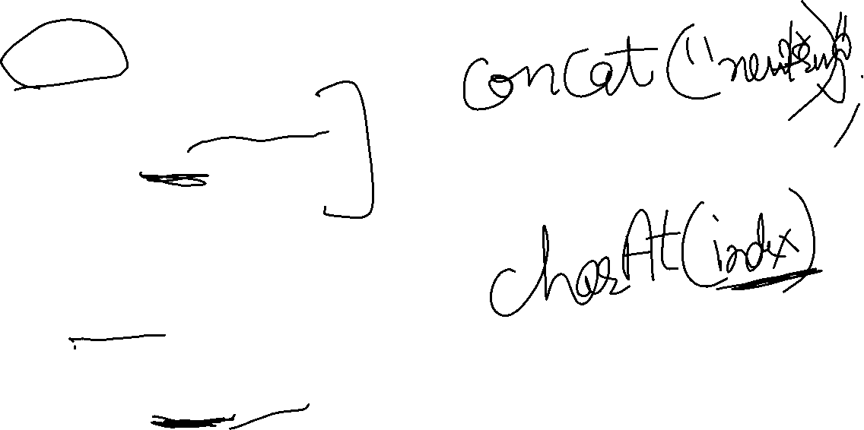
Introduction to Java
Java String Class Methods (Cont..)
concat()
Adding two string we use this method
Example: String s=“programming”;
s=s.concat(“software”);
System.out.Println(s);
int length();
Returns the number of characters in the string
Example: “problem”.length();
char charAt(i);
Returns the char at postion i.
Example: “window”.charAt(2);

Slide 9
Java String Class Methods (Cont..)
6. toUpperCase() and toLowerCase()
prints uppercase and lowercase versions of string
Example
String s = " Java 2 Certification ";
System.out.println(s);
System.out.println(s.toUpperCase());
System.out.println(s.toLowerCase());
7. indexOf()
provide the index of char literal provided
Example: String s=“Java Programming Language”
Int i=s.indexOf(‘J’)

Slide 10

8. toCharArray()
convert the string to a char array
String s=“Hello”;
char ch[] = s.toCharArray();

Slide 11

String Comparison and Test Methods
compareTo()
The java compares two strings based on the Unicode value of each character in the strings. If two strings are different, then they have different characters at some index that is a valid index for both strings, or their lengths are different, or both.
Assuming index ‘i’ is where characters are different then compareTo() will return firstString.charAt(i)-secondString.charAt(i).

Slide 12

endsWith() and startsWith().
This method of the String class checks whether the given string ends with the specified string suffix or not.
Syntax
endsWith(String suffix)
Parameter: This method takes one parameter that is of string type..
Return type: This method returns a boolean value true or false. the i.e string ends with a specified suffix or not.

Slide 13
startsWith() method
This method of the String class checks whether the given string starts with the specified string prefix or not.
Syntax:
startsWith(String prefix)
Parameter: This method takes one parameter that is of string type..
Return type: This method returns a boolean value true or false. the i.e string ends with a specified prefix or not.

Slide 14
StringTokenizer
The java.util.StringTokenizer class supports breaking a line of texts into tokens
String str = "Code Quotient Get Better at Coding";
String strReverse;
StringBuilder sb = new StringBuilder();
StringTokenizer st = new StringTokenizer(str);
while (st.hasMoreTokens())
{
sb.insert(0, st.nextToken());
if (st.hasMoreTokens())
sb.insert(0, " ");
}
strReverse = sb.toString();
System.out.println(strReverse);

Slide 15
String split() method
String str = "Code Quotient Get Better at Coding";
String[] tokens = str.split("\\s"); // white space '\s' as delimiter
StringBuilder sb = new StringBuilder();
for (int i = 0; i < tokens.length; ++i)
{
sb.insert(0, tokens[i]);
if (i < tokens.length - 1)
sb.insert(0, " ");
}
String strReverse = sb.toString();
System.out.println(strReverse);

Slide 16
Introduction to Java
Self Assessment Questions
Which of these operators can be used to concatenate two or more String objects?
+
+=
&
||
Answer:

Slide 17
Introduction to Java
Self Assessment Questions
Which of these method of class String is used to obtain length of String object?
get()
Sizeof()
lengthof()
length()
Answer:

Slide 18
Introduction to Java
Self Assessment Questions
Which of these constructors is used to create an empty String object?
String()
String(void)
String(0)
None of the mentioned
Answer:

Slide 19

Introduction to Java
Document Links
Topics | URL | Notes
String manipulation | https://www.guru99.com/javastrings.html | This document explains about various string manipulations with examples

Slide 20

Introduction to Java
Video Links
Topics | URL | Notes
Strings in Java | https://www.youtube.com/watch?v=4l50UaPca7Y | This video will explain different string class methods and immutable strings.

Slide 21
Introduction to Java
E-Book Links
Topics | URL
Java The Complete Reference, Seventh Edition | http://iiti.ac.in/people/~tanimad/JavaTheCompleteReference.pdf
Introduction to Programming Using Java, Y. Daniel Liang:, 6th Edition, Pearson Education, 2007. | http://www.iitk.ac.in/esc101/share/downloads/javanotes5.pdf
Jim Keogh: J2EE The Complete Reference, Tata McGraw Hill, 2007. | https://web.iiit.ac.in/~nagarjuna.psug08/J2ME%20-%20The%20Complete%20Reference.pdf
Core Java Integrated approaches by nageshwara Rao 2009 edition. | https://dlscrib.com/corejavabynageswararaopdffreedownload_58e07938dc0d6067718970ed_pdf.html

